Slide 1


Network protocols & security
24EC2210
Topic:
A Security Model, Asymmetric & Symmetric key Ciphers
Session – 34

Slide 2
Classic Encryption Techniques
Plain Text: Original Message
Encryption/Encipherment: Process of Converting from Plain text to Cipher text
Decryption/Decipherment: Restoring the plaintext from the cipher text.
Cryptography: Many schemes used for encryption.
Cryptanalysis: Techniques for deciphering a message without any knowledge of the enciphering details.
Cryptology: areas of Cryptography and Cryptanalysis together are called Cryptology

Slide 3
Classic Encryption Techniques
Encryption Algorithm: Performs various substitution and transpositions on the plain text.
Secret Key: Value independent of plain text and the algorithm.
Cipher Text: Scrambled Message produced as Output.
Decryption Algorithm: Encryption Algorithm in reverse.

Slide 4
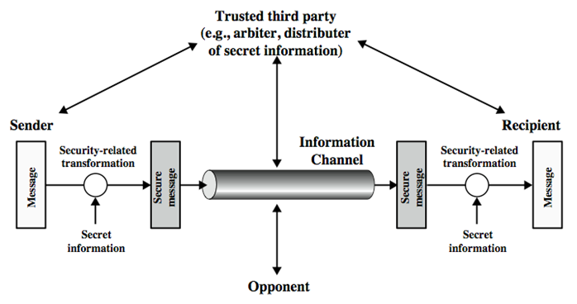
A Model for Network Security

Slide 5
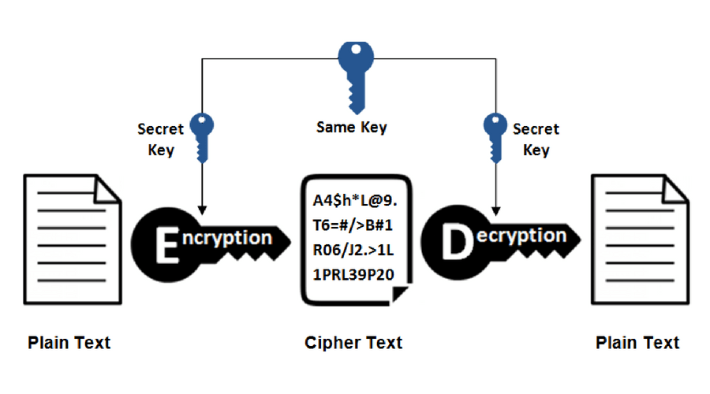
Cryptography
Cryptography is technique of securing information and communications through use of codes so that only those person for whom the information is intended can understand it and process it. Thus preventing unauthorized access to information.
The prefix “crypt” means “hidden” and suffix “graphy” means “writing”.

Slide 6
Cryptography
Cryptography is associated with the process of converting ordinary plain text into incomprehensible text and vice-versa.
It is a method of storing and transmitting data in a particular form so that only those for whom it is intended can read and process it.
1. Symmetric key Cryptography
- Symmetric encryption is also called secret key encryption, and it uses just one key, called a shared secret, for both encrypting and decrypting.
- This method is the opposite of Asymmetric Encryption where one key is used to encrypt and another is used to decrypt.

Slide 7
Cryptography
2. Public key cryptography
- uses a pair of keys to encrypt and decrypt data to protect it against unauthorized access or use.
NOTE: Symmetric cryptography was one-type prior to invention of public-key in 1970’s and by far most widely used (still) is significantly faster than public-key cryptography.

Slide 8
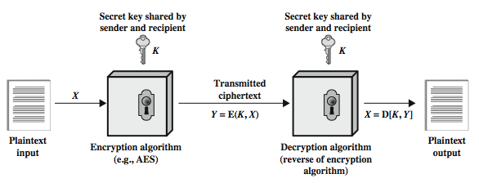
Symmetric Cipher Model

Slide 9
Symmetric Cipher Model
Two requirements for secure use of symmetric encryption:
- a strong encryption algorithm
- a secret key known only to sender / receiver
Mathematically
Y = E(K, X) = E_{K}(X)
X = D(K, Y) = D_{K}(Y)
A secure channel is required to distribute the key, this is a big problem in symmetric cryptography

Slide 10
Symmetric Cipher Model
Cryptographic algorithms are characterized by the type of encryption operations used
substitution, transposition, product
Substitution: Elements of plain text is mapped with another element
Transposition: Elements of plaintext are rearranged
Product: Combination of Substitution and Transposition

Slide 11
Symmetric Cipher Model
The way in which plaintext is processed
Block Cipher: Input is Processed one block at a time and outputs a block
Stream Cipher: Process the input element one at a time and outputs one element at a time.

Slide 12
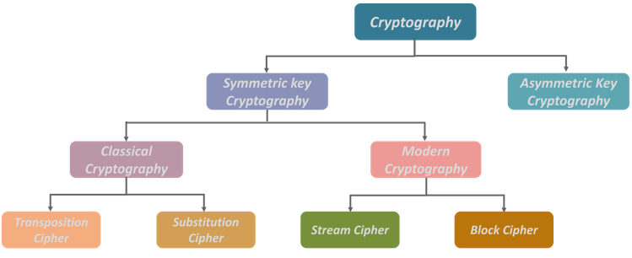
Cryptography Methods

Slide 13
Symmetric Cryptography

Slide 14
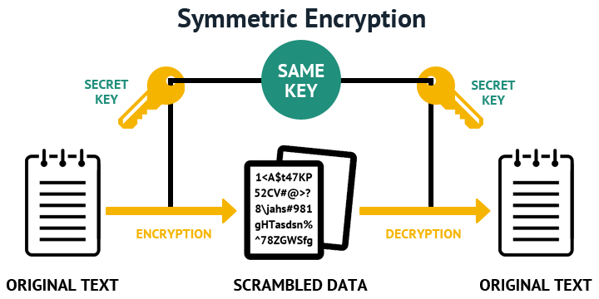
Symmetric Cryptography
Symmetric encryption is a data encryption method whereby the same key is used to encode and decode information.

Slide 15
Classical Symmetric Encryption Methods
Substitution Ciphers
Is a technique in which plaintext letters are replaced with other letters, numbers, or symbols.
Substitution Cipher Methods:
Caesar Cipher
Mono-alphabetic Cipher
Playfair Cipher
Transposition Ciphers
Is a technique where the order of alphabets in the plaintext is rearranged to form a cipher text.
Transposition Cipher methods:
Columnar Cipher
Rail fence Cipher

